Slide 1

Java MVC Frameworks
Spring Boot Introduction
SoftUni Team
Technical Trainers
Software University
http://softuni.bg

Slide 2
Table of Contents
What’s Spring Boot?
What’s Spring MVC?
Spring Data

Slide 3
Questions
sli.do #java-web

Slide 4

What is Spring Boot?

Slide 5




Spring Boot
Opinionated view of building production-ready Spring applications
Tomcat
pom.xml
Spring Boot
Auto configuration

Slide 6
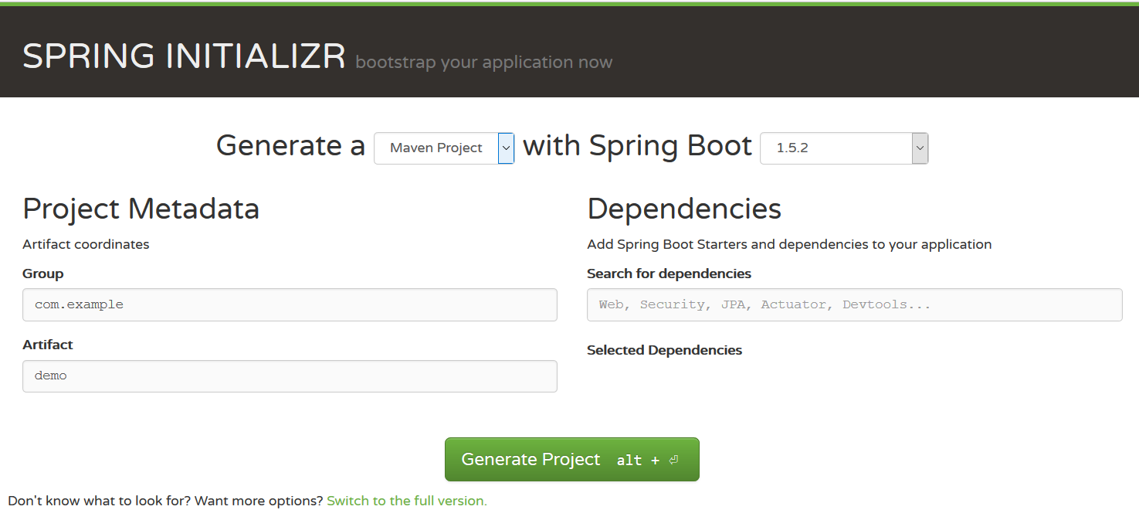
Creating Spring Boot Project
Just go to https://start.spring.io/

Slide 7
Spring Dev Tools
Additional set of tools that can make the application development faster and more enjoyable
pom.xml
<dependency> <groupId>org.springframework.boot</groupId> <artifactId>spring-boot-devtools</artifactId> <scope>runtime</scope> </dependency>

Slide 8
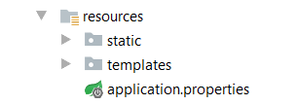
Spring Resources
HTML, CSS, JS
Thymeleaf templates
Application properties

Slide 9
Spring Boot Main Components
Four main components:
Spring Boot Starters - combine a group of common or related dependencies into single dependency
Spring Boot Auto-Configuration - reduce the Spring Configuration
Spring Boot CLI - run and test Spring Boot applications from command prompt
Spring Boot Actuator – provides EndPoints and Metrics

Slide 10
Spring Boot Starters
spring-boot-starter-web
spring-boot-starter-tomcat
spring-web
spring-boot-starter
spring-web-mvc
spring-boot
tomcat-embed-logging-juli
spring-boot-autoconfigure
tomcat-embed-core
spring-boot-starter-logging

Slide 11
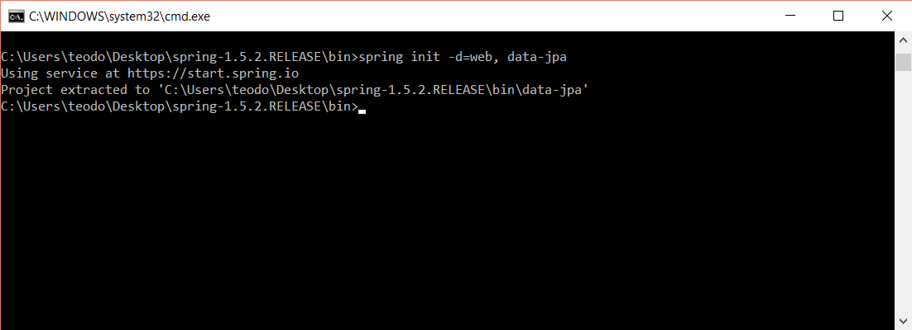
Spring Boot CLI
Command Line Interface - Spring Boot software to run and test Spring Boot applications

Slide 12
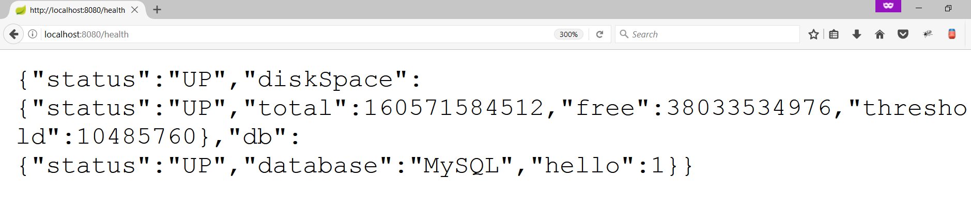
Spring Boot Actuator
Expose different types of information about the running application
pom.xml
<dependency>
<groupId>org.springframework.boot</groupId>
<artifactId>spring-boot-starter-actuator</artifactId>
</dependency>

Slide 13
Inversion of Control
Spring provides Inversion of Control and Dependency Injection
UserServiceImpl.java
UserServiceImpl.java
//Tradiotional Way
public class UserServiceImpl implements UserService {
private UserRepository userRepository = new UserRepository();
}
//Dependency Injection
@Service
public class UserServiceImpl implements UserService {
@Autowired
private UserRepository userRepository;
}

Slide 14
Spring IoC
Meta Data:
XML Config
Java Config
Annotation Config
Automatic Beans:
@Component
@Service
@Repository
Explicit Beans
1. @Bean
IoC
Fully Configured System

Slide 15
Beans
Object that is instantiated, assembled, and otherwise managed by a Spring IoC container
Dog.java
public class Dog implements Animal {
private String name;
public Dog() {}
//GETTERS AND SETTERS
}

Slide 16
Bean Declaration
Dog.java
@SpringBootApplication
public class MainApplication {
…
@Bean
public Animal getDog(){
return new Dog();
}
}
Bean Declaration

Slide 17
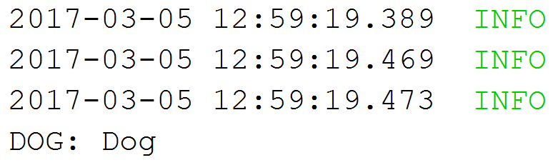
Get Bean from Application Context
MainApplication.java
@SpringBootApplication
public class MainApplication {
public static void main(String[] args) {
ApplicationContext context = SpringApplication.run(MainApplication.class, args);
Animal dog = context.getBean(Dog.class);
System.out.println("DOG: " + dog.getClass().getSimpleName());
}
}

Slide 18
Bean Lifecycle
Instantiation
Set Properties
Set Name
Initialization
Pre Initialization
Set Application Context
When Container is Shutdown
Post Initialization
Bean is ready
Bean is destroyed

Slide 19
Bean Lifecycle Demo (1)
MainApplication.java
@SpringBootApplication
public class MainApplication {
public static void main(String[] args) {
ApplicationContext context = SpringApplication.run(MainApplication.class, args);
((AbstractApplicationContext)context).close();
}
@Bean(destroyMethod = "destroy", initMethod = "init")
public Animal getDog(){
return new Dog();
}
}

Slide 20

Bean Lifecycle Demo (2)
MainApplication.java
public class Dog implements Animal {
public Dog() {
System.out.println("Instantiation");
}
public void init(){
System.out.println("Initializing..");
}
public void destroy(){
System.out.println("Destroying..");
}
}

Slide 21
Bean Scope
The default one is Singleton. It is easy to change to Prototype
Mostly used as State-less
Mostly used as State-full
Singleton
Prototype
Request A
Request A
Dog 1
Request B
Dog
Request B
Dog 2
Request C
Request C
Dog 3

Slide 22
What is Spring MVC?

Slide 23
What is Spring MVC?
Model-view-controller (MVC) framework is designed around a DispatcherServlet that dispatches requests to handlers
Find Controller
Handler
Mapping
Controller
Service
Request
Dispatcher Servlet
Execute Action
Handler
Adapter
View Name
Repository
View
Resolver
Result Model
Resolve View
DB
Response
Result Model
View
Model
Business Logic
Notes:
Blue Color – Provided by Spring Purple Color – To Be Implemented by the Developer Green Color – Provided by Spring. Sometimes implemented by the developer

Slide 24
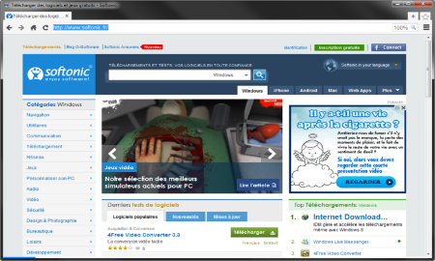



MVC – Control Flow
Web Client
Request
Controller
Response (html, json, xml)
Update Model
User Action
Update View
Notify
Model
View

Slide 25
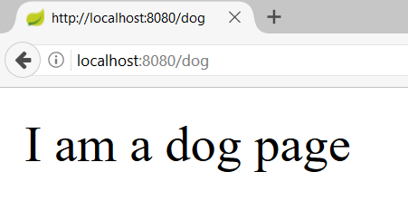
Controllers
Controller
DogController.java
@Controller
public class DogController {
@GetMapping("/dog")
@ResponseBody
public String getDogHomePage(){
return "I am a dog page";
}
}
Request Mapping
Action
Print Text
Text

Slide 26
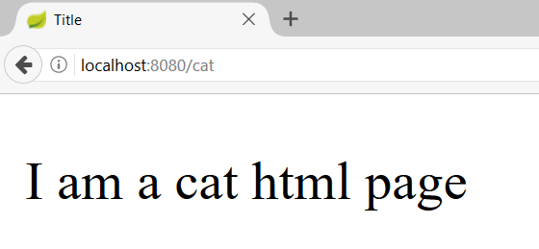
Actions – Get Requests
CatController.java
@Controller
public class CatController {
@GetMapping("/cat")
public String getHomeCatPage(){
return "cat-page.html";
}
}
Request Mapping
Action
View
26

Slide 27
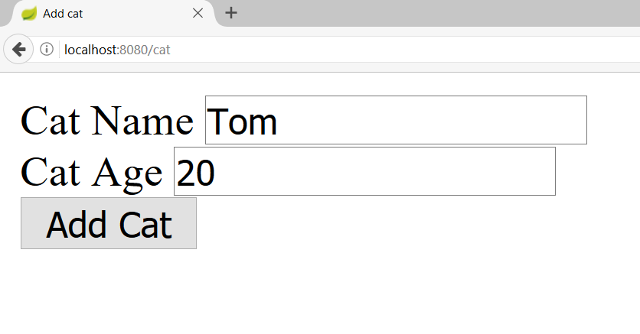
Actions – Post Requests (1)
CatController.java
@Controller
@RequestMapping("/cat")
public class CatController {
@GetMapping("")
public String getHomeCatPage(){
return "new-cat.html";
}
}
Starting route

Slide 28

Actions – Post Requests (1)
CatController.java
@Controller
@RequestMapping("/cat")
public class CatController {
@PostMapping("")
public String addCat(@RequestParam String catName, @RequestParam int catAge){
System.out.println(String.format("Cat Name: %s, Cat Age: %d", catName, catAge));
return "redirect:/cat";
}
}
Request param
Redirect

Slide 29
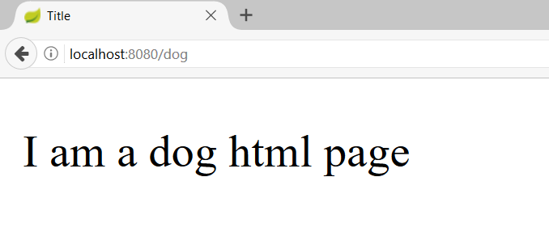
Models and Views
DogController.java
@Controller
public class DogController {
@GetMapping("/dog")
public ModelAndView getDogHomePage(ModelAndView modelAndView){
modelAndView.setViewName("dog-page.html");
return modelAndView;
}
}
Model and View

Slide 30
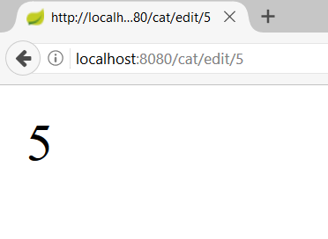
Path Variables
CatController.java
@Controller
@RequestMapping("/cat")
public class CatController {
@GetMapping("/edit/{catId}")
@ResponseBody
public String editCat(@PathVariable long catId){
return String.valueOf(catId);
}
}
Path Variable

Slide 31

Spring Data

Slide 32
Overall Architecture
Repository
Service
Controller
Database
View
Entities
Models/ DTO
Back-end

Slide 33
Application Properties
application.properties
#Data Source Properties
spring.datasource.driverClassName=com.mysql.jdbc.Driver
spring.datasource.url=jdbc:mysql://localhost:3306/cat_store?useSSL=false&createDatabaseIfNotExist=true
spring.datasource.username=root
spring.datasource.password=1234
#JPA Properties
spring.jpa.properties.hibernate.dialect=org.hibernate.dialect.MySQL5InnoDBDialect
spring.jpa.properties.hibernate.format_sql=TRUE
spring.jpa.hibernate.ddl-auto=update

Slide 34
Entities
Entity is a lightweight persistence domain object
Cat.java
@Entity
@Table(name = "cats")
public class Cat {
@Id
@GeneratedValue(strategy = GenerationType.IDENTITY)
private long id;
private String name;
//GETTERS AND SETTERS
}

Slide 35
Repositories
Persistence layer that works with entities
CatRepository.java
@Repository
public interface CatRepository extends CrudRepository<Cat, Long> {
}

Slide 36
Services
Business Layer. All the business logic is here.
CatService.java
@Service
public class CatServiceImpl implements CatService {
@Autowired
private CatRepository catRepository;
@Override
public void buyCat(CatModel catModel) {
//TODO Implement the method
}
}

Slide 37


Summary
Spring Boot - Opinionated view of building production-ready Spring applications
Spring MVC - MVC framework that has three main components:
Controller - controls the application flow
View - presentation layer
Model - data component with the main logic
Spring Data - Responsible for database related operations

Slide 38
https://softuni.bg/trainings/courses

Slide 39













SoftUni Diamond Partners

Slide 40




SoftUni Organizational Partners

Slide 41




Trainings @ Software University (SoftUni)
Software University – High-Quality Education and Employment Opportunities
softuni.bg
Software University Foundation
http://softuni.foundation/
Software University @ Facebook
facebook.com/SoftwareUniversity
Software University Forums
forum.softuni.bg

Slide 42

License
This course (slides, examples, demos, videos, homework, etc.) is licensed under the "Creative Commons Attribution-NonCommercial-ShareAlike 4.0 International" license

